Slide 1
Movie Recommendation Using Metadata Based Word2Vec Algorithm Yeo Chan Yoon ; Jun Woo Lee PlatCon 2018, South Korea
報告者：陳克威
日 期：2019/09/17
Notes:
Word2vec 給 corpus 裡頭的單字轉成 vector
將單字做one hot encoding,
算單字出現機率，用神經網路back propagation來train.

Slide 2
Outline
Introduction
Related Works
Proposed Method
Evaluation
Conclusions

Slide 3
Introduction

Slide 4
Introduction
In this paper, we propose a method to recommend movie using metadata information based on Word2Vec algorithm.
Using metadata information, the proposed method could effectively recommend recently released item which have been rarely used.
This method is also excellent for finding similar item by comparing embedding of each item.

Slide 5
Related Work

Slide 6
Related Work
A. Collaborative Filtering
Amazon.com recommendations: Item-to-item collaborative filtering
Metadata embeddings for user and item cold-start recommendations
Cross-domain collaborative recommendation in a cold-start context: The impact of user profile size on the quality of recommendation
Improving regularized singular value decomposition for collaborative filtering
Collaborative topic modeling for recommending scientific articles
Notes:
Item-Item 計算物品相似度。
Metadata embedding。
Cross-domain 用user的額外信息，如社群資料。
SVD奇異值分解 -> 降維
Topic modeling

Slide 7
Related Work
B. Content Based
HybridRank: A Hybrid Content-Based Approach To Mobile Game Recommendations
A multi-view deep learning approach for cross domain user modeling in recommendation systems
Notes:
透過PageRank用metadata來建構similarity graph。
將音樂做embedding成vector來找相似歌曲。

Slide 8
Related Work
C. Deep Learning
Deep neural networks for youtube recommendations
The Xbox recommender system
Notes:
1. Youtube推薦算法。
2. Liner model + deep learning 做推薦，也使用embedding。

Slide 9
Proposed Method

Slide 10
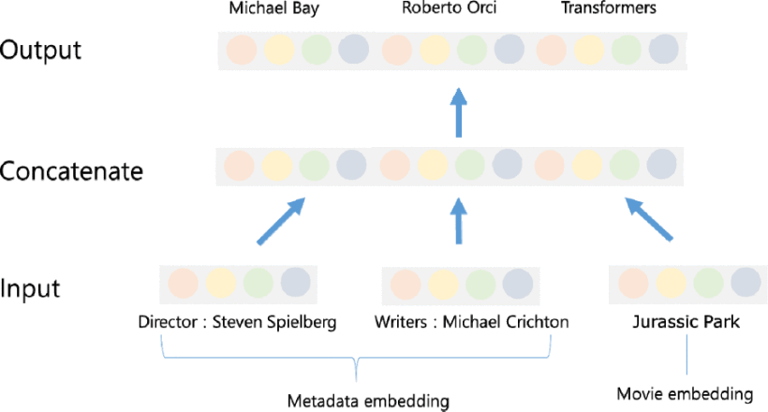
Proposed Method
The proposed method exploits various metadata of movie, such as movie director, actor, production year, production cost, movie tag and so on.
Values of these metadata are embedded as vector and are used as input and output of proposed Word2Vec network.
Movie embedding is also used as input and output with meta data embedding.

Slide 11
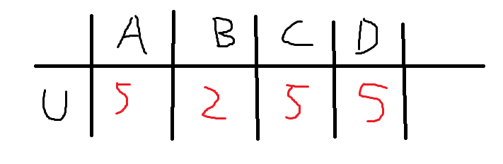
A. Training Embedding of Each Movie
The input and output pairs can be obtained from the user's movie purchase and viewing history data.
For example, if a user watches four movies A, B, C, D and assigns five, two, five and five rating to each movie, the pairs of movie (A and C), (A and D) and (C and D) are set to positive examples which are used to train the Word2Vec network.

Slide 12
A. Training Embedding of Each Movie
The movie and metadata vectors given as inputs are initialized with pretrained embedding using the Word2vec algorithm.
1. The movies rated highest score by the same user, pairs of metadata included in the movies are used as input and output of the Word2Vec network.
2. If a movie contains two tags (#Smooth, #Romantic), it is used as training example.
Notes:
Word2Vec就是算每個詞出現的位置的機率(利用上下文)，先做one-hot encoding。

Slide 13

B. Prediction of User Vector
viewing time of the user u
of the i-th movie.
user u's latent vector
vector of the i-th movie

Slide 14

C. Generation of Recommend List
In this paper, we use the inner product of the item vector and the user vector in order to rank the movies for each user.
predicted rating for the movie i of user u
average rating of the movie u
average rating of the entire movie
average rating of the movie i
Notes:
預測User對item的rating
全部item的平均rating
此user對item的平均rating
這個item的平均rating

Slide 15
Evaluation

Slide 16
Evaluation
We evaluate our method on movie data.
The experimental results were measured using the Recall©M measure.
The Item2Vec method proposed by Barkan and the SVD-based method which is frequently used for collaborative filtering are used as comparable methods.

Slide 17
A. Dataset
A well-known MovieLens[13] 10M data set was used for the experiment set.
The MovieLens dataset consists of 10681 movies, and about 10 million movie ratings by 71567 users.

Slide 18
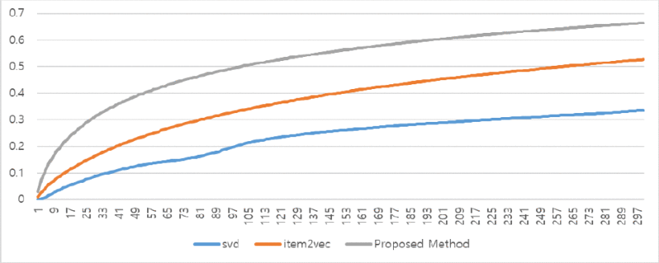
B. Experimental Result
Based on Recall©100, the performance of the proposed method is 0.498,
which is 0.165 superior to the item2vec performance of 0.333.
Notes:
Recall: 有找到/有找到+沒找到
TP/TP + False N

Slide 19
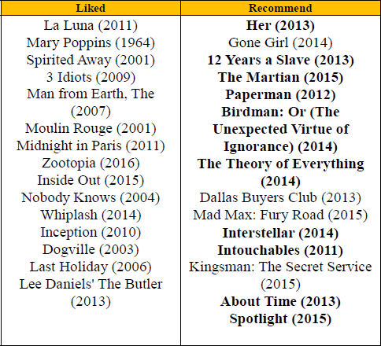
B. Experimental Result
粗體 表示用戶對推薦結果滿意

Slide 20
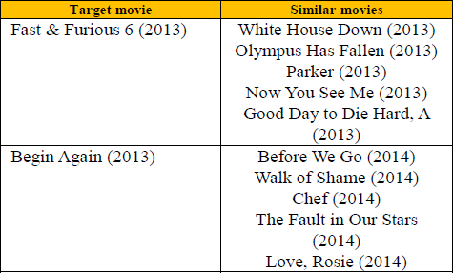
B. Experimental Result
shows the results of finding a similar movie using a movie vector.
Using a cosine similarity, a movie with a smaller distance from the target vector was judged as a similar movie.
For the action black buster movie Fast & Furious 6, we can see the recommend results include movies in similar genres;
and for the romantic movie Begin Again, we can see the lyrical movies were recommended as results.

Slide 21
Conclusions

Slide 22
Conclusions
In this paper, we proposed a method using metadata to embed movie and user for movie recommendation service.
The proposed method showed higher performance than the baseline method using only user usage data.
We also could represent user as vector by summing up the user-preferred-movie's vector.
The example shows that the proposed method is very effective in recommending movie.
Notes:
3.我們可以通過總結用戶首選電影的向量來將用戶表示為向量。

Slide 23
Thanks for listening.
報告者：陳克威
日 期：2019/09/17

